Slide 1
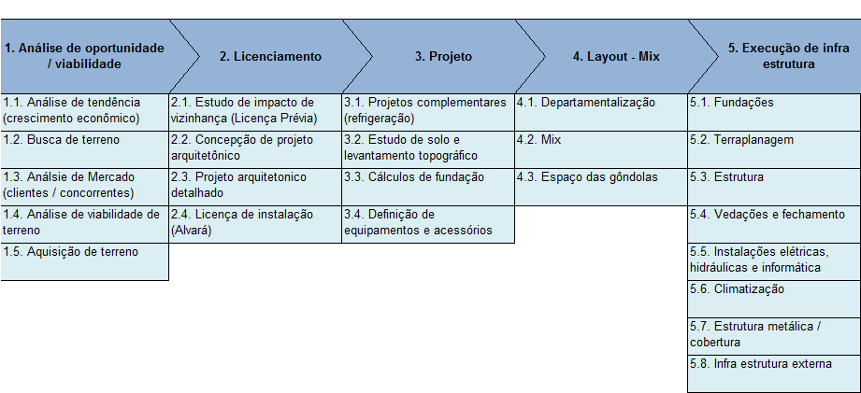
AMPLIAÇÃO E ADEQUAÇÃO LOJAS 03/06
Coordenador: Aliceu
Participantes do projeto: 12 colaboradores Condor
Etapas AMPLIAÇÃO :
Notes:
What is the project about?
Define the goal of this project
Is it similar to projects in the past or is it a new effort?
Define the scope of this project
Is it an independent project or is it related to other projects?
* Note that this slide is not necessary for weekly status meetings

Slide 2
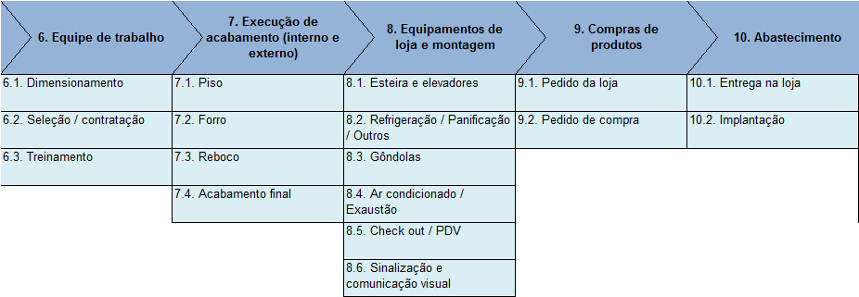
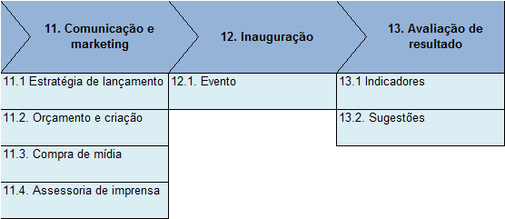
Etapas (cont.):
Notes:
What is the project about?
Define the goal of this project
Is it similar to projects in the past or is it a new effort?
Define the scope of this project
Is it an independent project or is it related to other projects?
* Note that this slide is not necessary for weekly status meetings

Slide 3
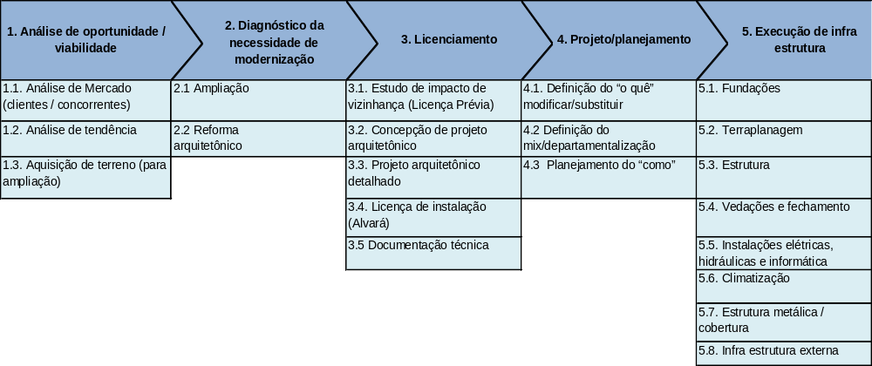
REFORMA DE LOJAS 04/07
Coordenador: Aliceu
Participantes do projeto: 12 colaboradores Condor
Etapas REFORMA :
Notes:
What is the project about?
Define the goal of this project
Is it similar to projects in the past or is it a new effort?
Define the scope of this project
Is it an independent project or is it related to other projects?
* Note that this slide is not necessary for weekly status meetings

Slide 4
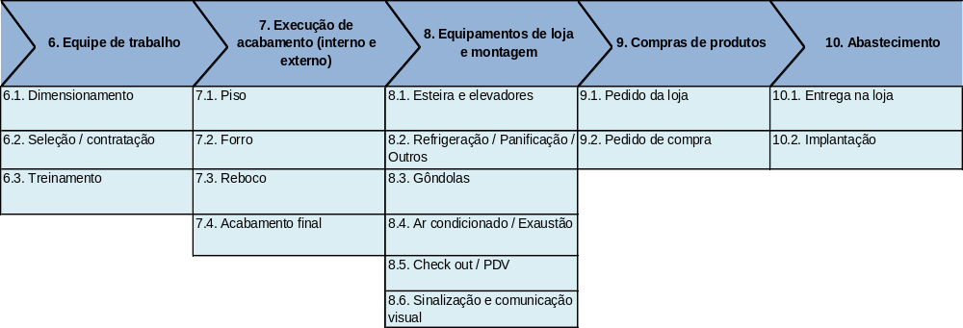
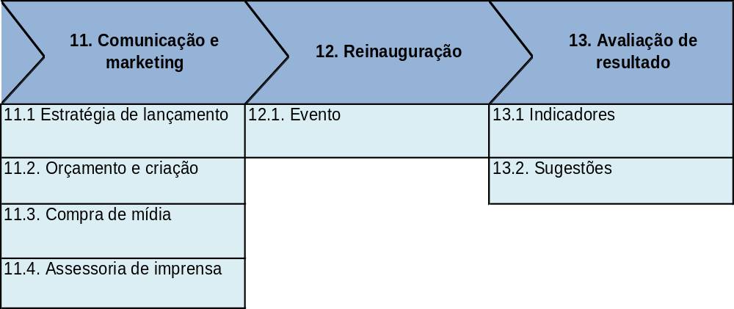
Etapas (cont.):
Notes:
What is the project about?
Define the goal of this project
Is it similar to projects in the past or is it a new effort?
Define the scope of this project
Is it an independent project or is it related to other projects?
* Note that this slide is not necessary for weekly status meetings

